Slide 1


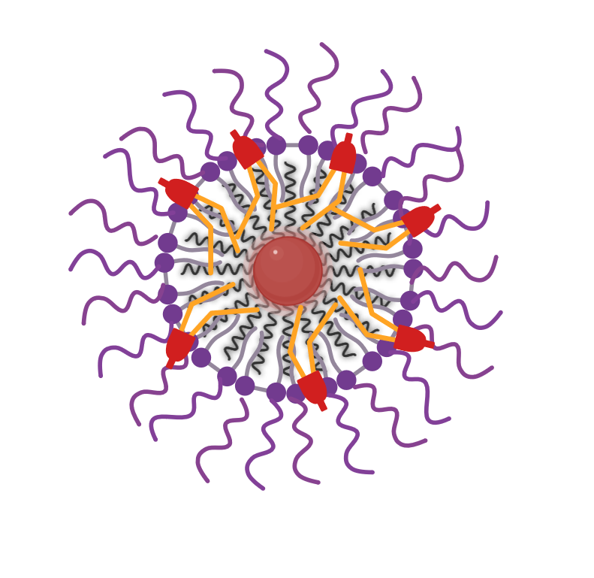

Dr Darius McPhail
Research Fellow, Medicines Discovery Institute
Cardiff University
Email: mcphaild@cardiff.ac.uk
Iron-Oxide Nanoparticle
Ferroptosis

Slide 2
Dr Darius McPhail
Cymrawd Ymchwil,
Y Sefydliad Darganfod Meddyginiaethau
Prifysgol Caerdydd
Email: mcphaild@cardiff.ac.uk
Nanoronyn Haearn-Ocsid
Fferoptosis

Slide 3

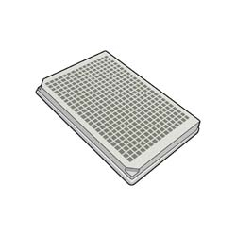

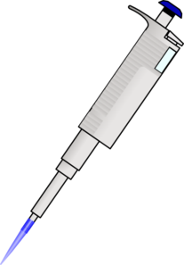





MDI Operational Strengths
Assay Design
Brain-Penetrant Drug Design
Lysosomal Storage Diseases
Neuropsychiatric
Disorders
Translational Medicinal Chemistry
Lead Optimisation
Phase III Batten-1
(Miglustat Reformulation)
CH₃
Drug A
Drug A+
Potency
Selectivity
Pharmacokinetics
Stability
Solubility
DT-101 in early phase II
DT-201
DT-301
>
Phase I, 2026

Slide 4
MDI Cryfderau gweithredol
Dyluniad y biobrawf
Dylunio Cyffuriau sy’n Treiddio i'r Ymennydd
Anhwylderau Storio Lysosomaidd
Anhwylderau
Niwroseiciatrig
Cemeg Feddyginiaethol Drosiadol
Optimeiddio arweiniol
Phase III Batten-1
(Ailfformiwleiddio Miglustat)
CH₃
Drug A
Drug A+
Cryfder
Detholedd
Ffarmacocineteg
Sefydlogrwydd
Hydoddedd
DT-101 in early phase II
DT-201
DT-301
>
Phase I, 2026

Slide 5
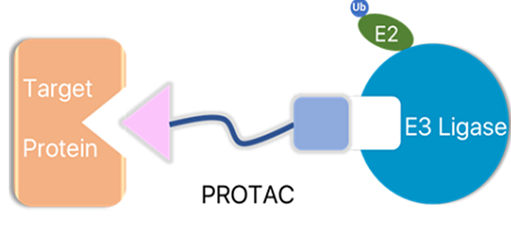
Cancer Drug Development
Collaborative Input
Tractability?
Assay Design
Screening
Lead Optimisation
Cancer Target Identification
(Simon Fraser University or
AstraZeneca.)
Preclinical → Clinical Translation
Internal Identification
Small Drug Inhibitors
Lysosomal Drug Repositioning (ASAH1 - Glioblastoma)
Kinase Inhibitors (GAK – Colorectal Cancer)
Other undisclosed targets.
PROTACs
KAT2A (DPFS Award)
Other undisclosed targets
Brain Penetrant Compounds

Slide 6
Datblygu Cyffuriau Canser
Mewnbwn Cydweithredol
Hydrinedd?
Dyluniad y biobrawf
Sgrinio
Optimeiddio arweiniol
Adnabod Targedau Canser
(Simon Fraser University or
AstraZeneca.)
Trosiad Cyn-glinigol → Clinigol
Adnabod Mewnol
Atalyddion Moleciwlau Bach
• Defnyddio Cyffuriau Lysosomaidd ar gyfer Triniaethau Eraill (ASAH1 - Glioblastoma)
• Atalyddion Cinasau (GAK – Canser y Colon a'r Rhefr)
• Targedau eraill heb eu datgelu
PROTACau
KAT2A (Dyfarniad DPFS)
Targedau eraill heb eu datgelu
Cyfansoddion sy’n Treiddio i’r Ymennydd

Slide 7



Expected Process and Available Aid
Mentorship
Drug Metabolism & Pharmacokinetics (DMPK) and other data interpretation.
Realistic development guidance.
Approval and regulatory conversations.
IP advice.
Entrepreneurship.
Collaboration Through Drug Discovery Pipeline
Target Identification and feasibility assessment.
Small funding + Cofunding.
Assay Design/Upscaling.
Medchem expertise/input.
Larger Funding applications. (DPFS, MRC)
Outsourced screening. (~£15,000, SFU)
Hit identification and optimisation.
Late stage company involvement/spinout.
Start
Industrial Connections

Slide 8
Proses Ddisgwyliedig a’r Cymorth Sydd Ar Gael
Mentoriaeth
Metabolaeth a Ffarmacocineteg Cyffuriau (DMPK) a dehongli data eraill.
Canllawiau datblygu realistig.
Sgyrsiau cymeradwyo a rheoleiddio.
Cyngor IP.
Entrepreneuriaeth.
Cydweithio Trwy’r Biblinell Darganfod Cyffuriau
• Adnabod targedau ac asesiad dichonoldeb.
• Symiau bach o gyllid + Cyd-gyllido.
• Ehangu’r cwmpas.
• Arbenigedd/mewnbwn Medchem.
• Ceisiadau Cyllid Mwy. (DPFS, MRC)
• Sgrinio wedi’i allanoli. (~£15,000, SFU)
• Adnabod ac optimeiddio darganfyddiadau.
• Cysylltiad/sefydlu cwmni yn y cyfnod hwyr.
Dechrau
Cysylltiadau gyda’r Diwydiant

Slide 9

Cardiff-MDI Collaborations
Strong Cancer
Biology Rationale
Translational
Research
McphailD@cardiff.ac.uk

Slide 10
Cydweithrediadau rhwng Caerdydd a’r Sefydliad Darganfod Meddyginiaethau
Rhesymeg Gref ar gyfer
Bioleg Canser
Ymchwil drosi
McphailD@cardiff.ac.uk

